Slide 1
Sensor Pod Configuration at TFRI with PRIME Week 3
Thaddeus Trinh
July 17, 2013

Slide 2
Proposed Research
To work with TFRI to help integrate new sensors into their Android sensor pod network and to deploy and test the new sensors in the field
Fuel Moisture Sensor
Solar Irradiation Sensor
Soil Moisture Sensor
Soil Drainage Gauge

Slide 3
Progress (Week 3)
Successfully identified a problem in the output current of the TFRI version of the sensor pod which was causing some sensors to give off strange values
Successfully installed and tested the Kipp Zonen Solar Irradiation Sensor
Added modularity to the sensor pod source code

Slide 4
Sensor Pod Progress and Problems
We were able to identify that the voltage regulators on the sensor pod board output a current that was too high (625 mA) for the sensors and lowering the current (~40 mA) gave a more reasonable output voltage
This may result in redesigning the board without the use of a 12V voltage regulator as seen in the two pictures on the next page
This has also fixed the issues we were having with the Fuel moisture sensor, the Solar Irradiation Sensor, and the CTD Sensor
Still need to determine how to read the Temperature output of the Fuel Moisture sensor, the Humidity output has been completed
Waiting on a SDI-12 to RS232 converter to use for the CTD Sensor

Slide 5
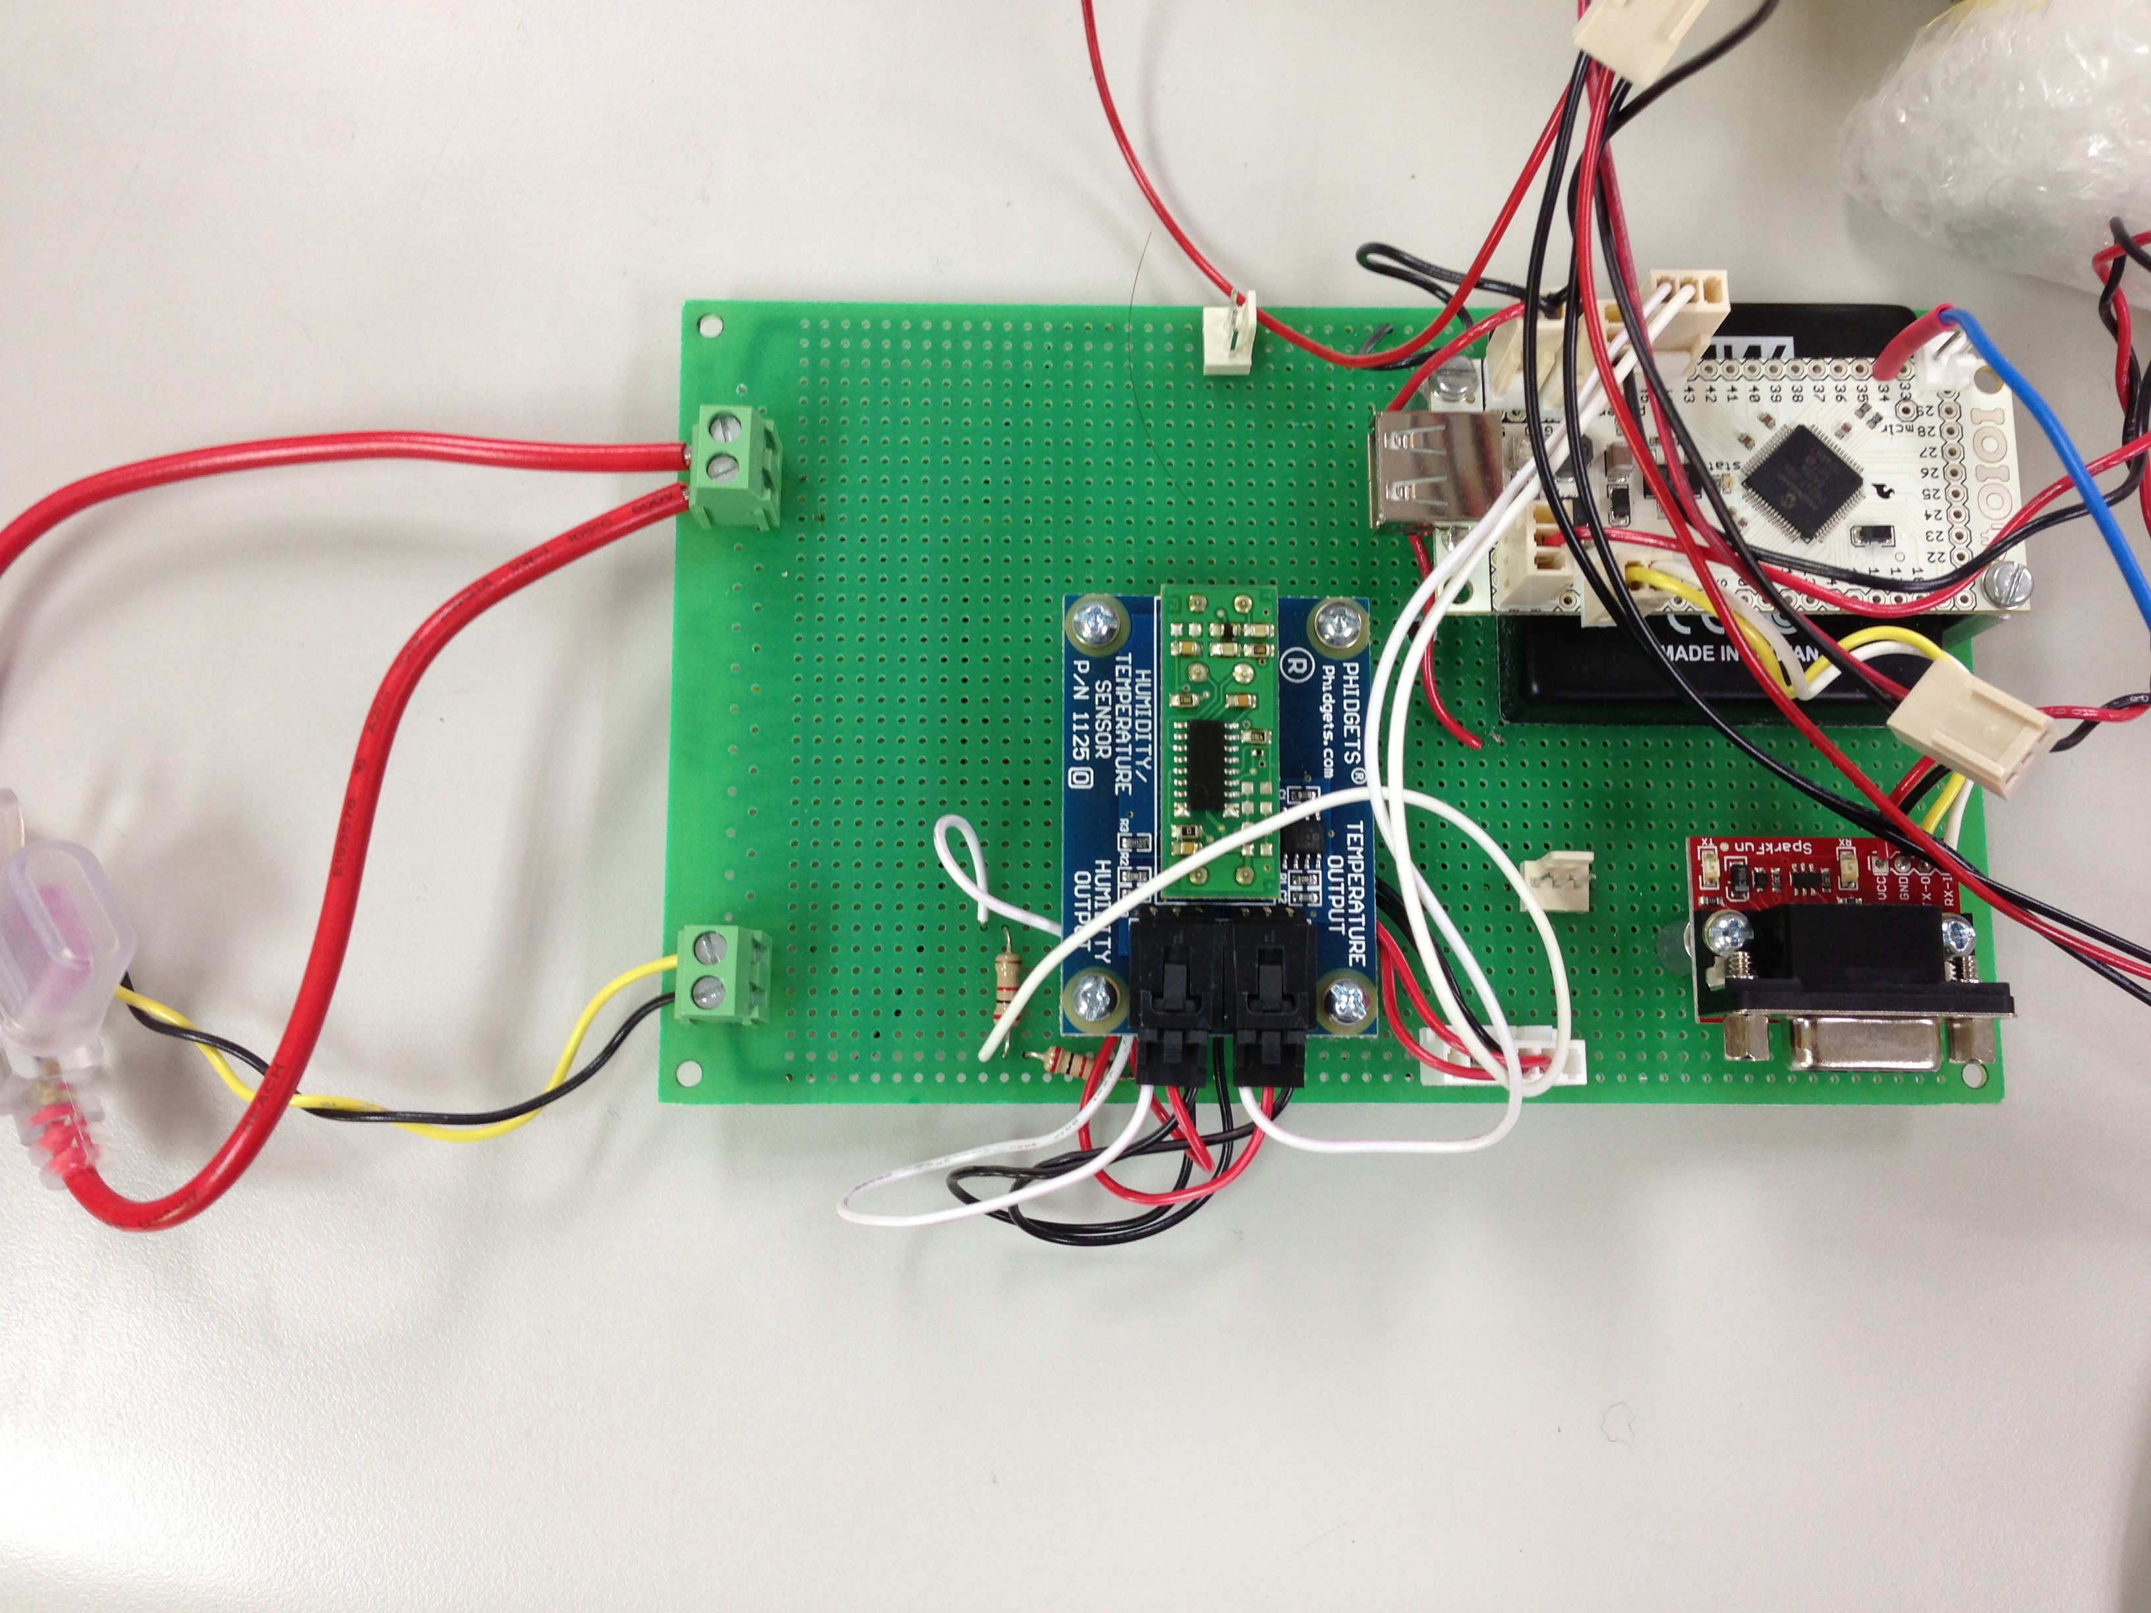
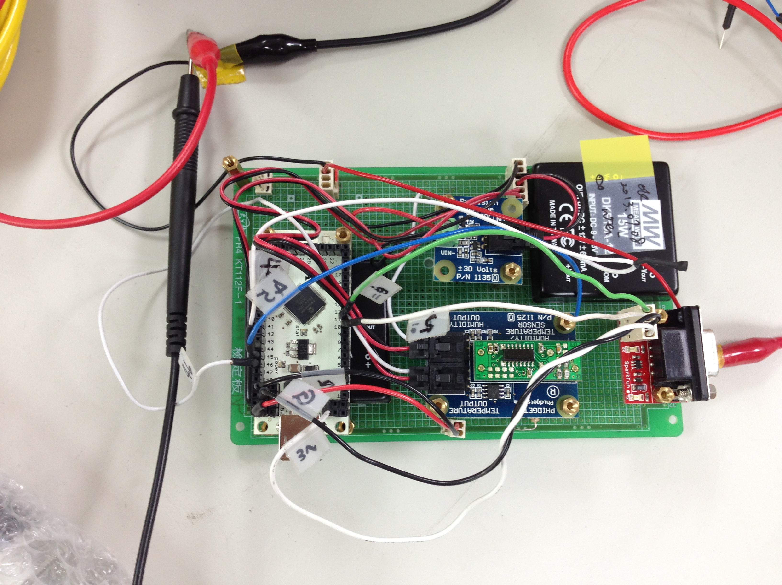
Left: Without a 12V voltage regulator
Right: Using a 12V voltage regulator

Slide 6
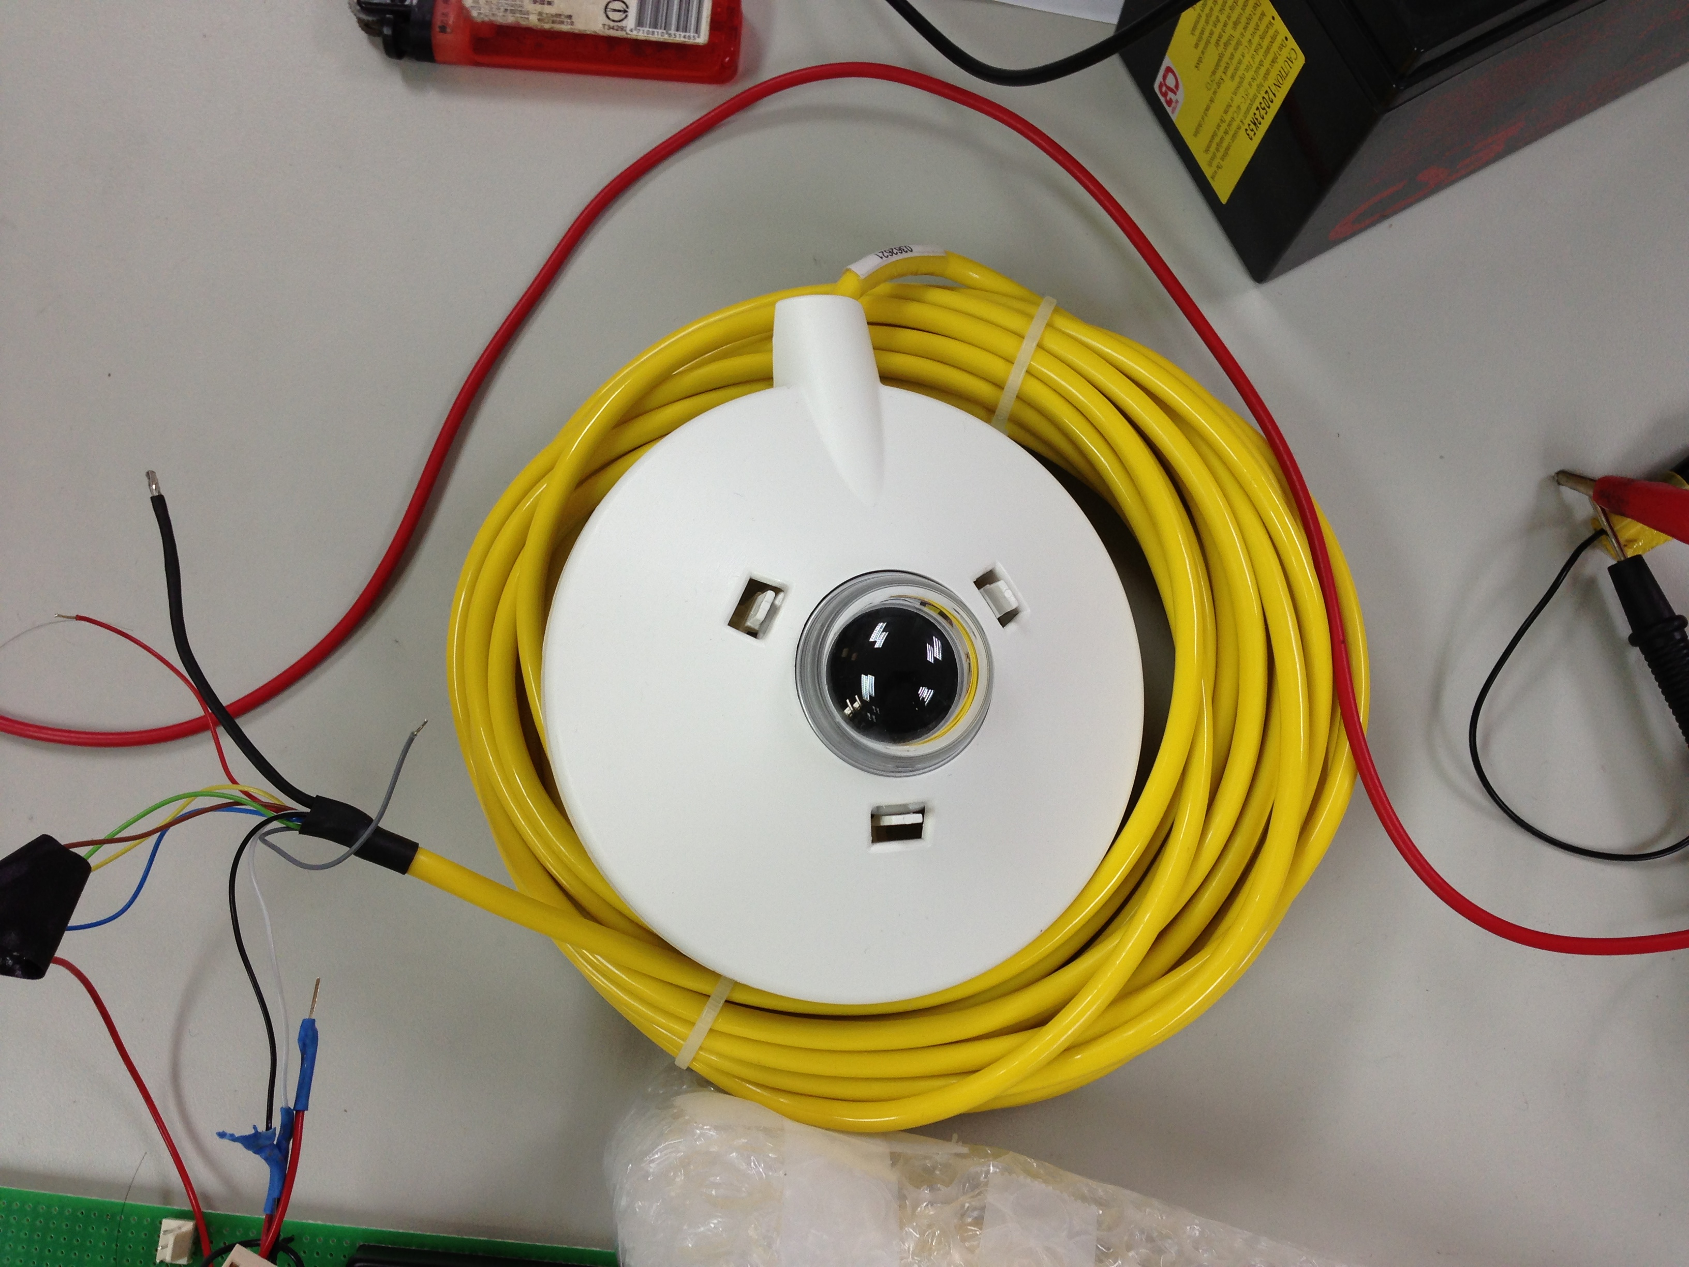
Solar Irradiation
Once the current problems were fixed, we were able to plug in the Solar Irradiation sensor and get reasonable voltage readings
Still must test with sending to a Data Turbine server

Slide 7
Sensor Pod Source Code
Added modularity to the sensor pod source code to allow users to choose which sensor was being read without actually modifying the source code
Using a modified version of SensorPodConfig.apk users are able to enter a letter which will correspond to the sensor that is chosen
Will eventually be updated to a drop-down list of available sensors to choose from

Slide 8
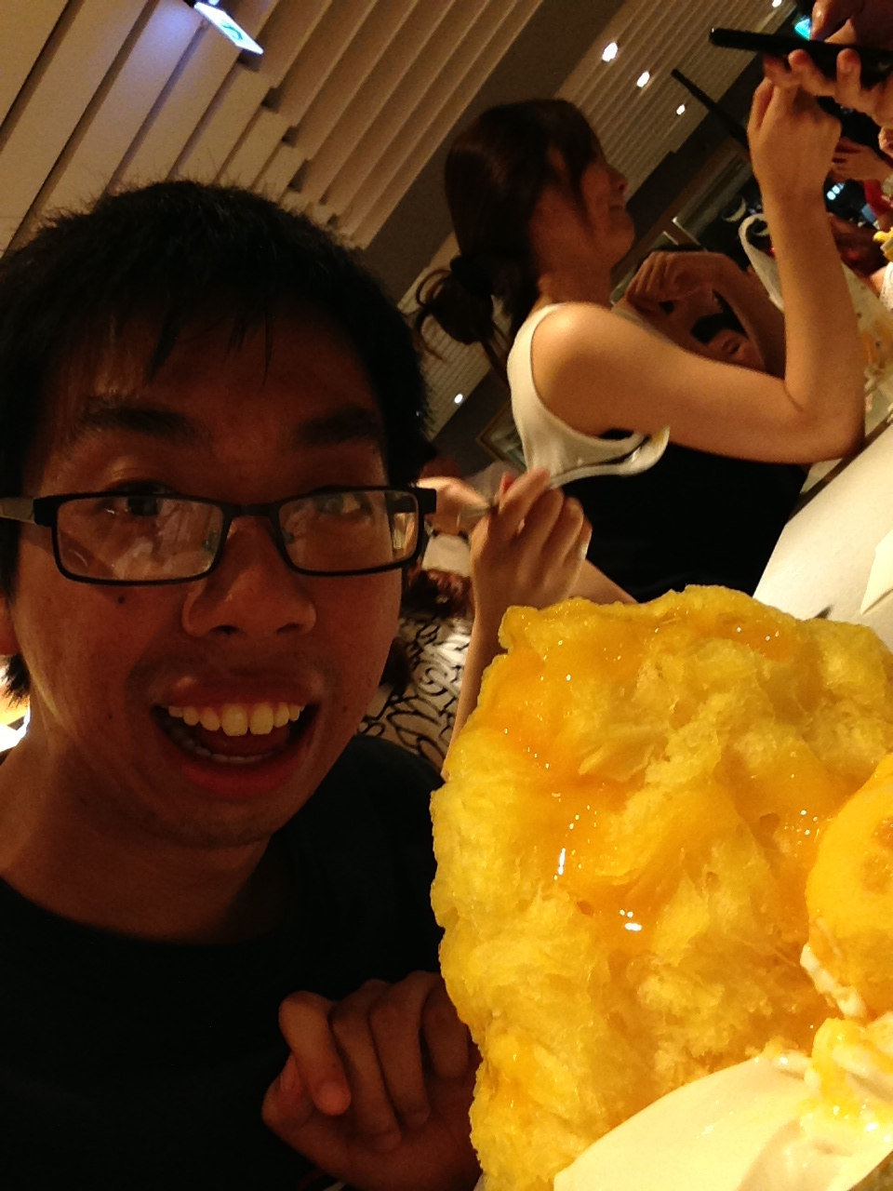
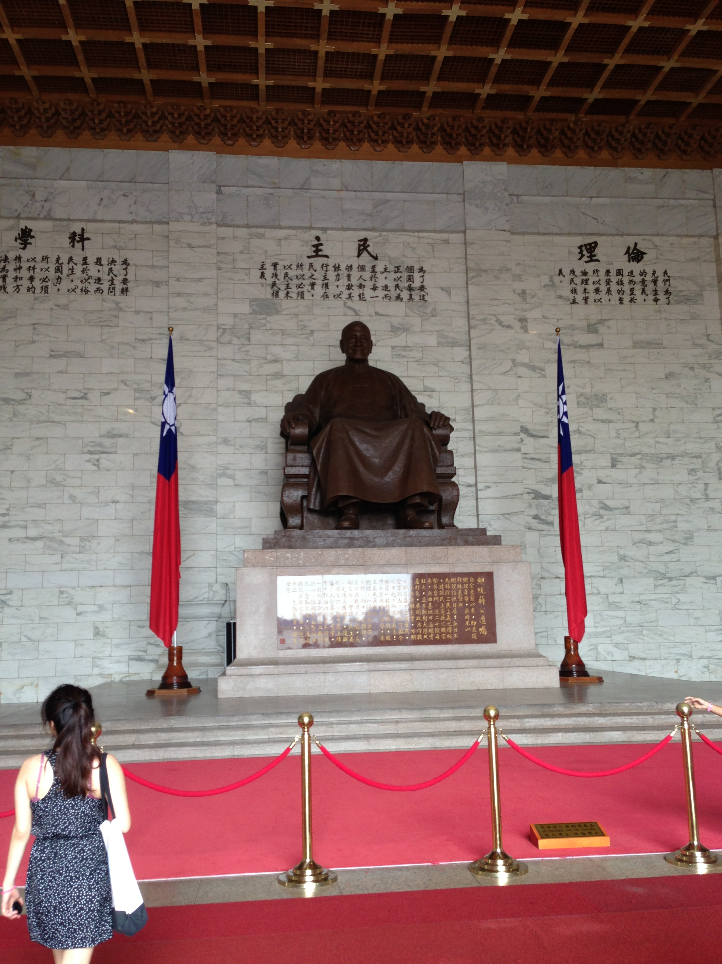
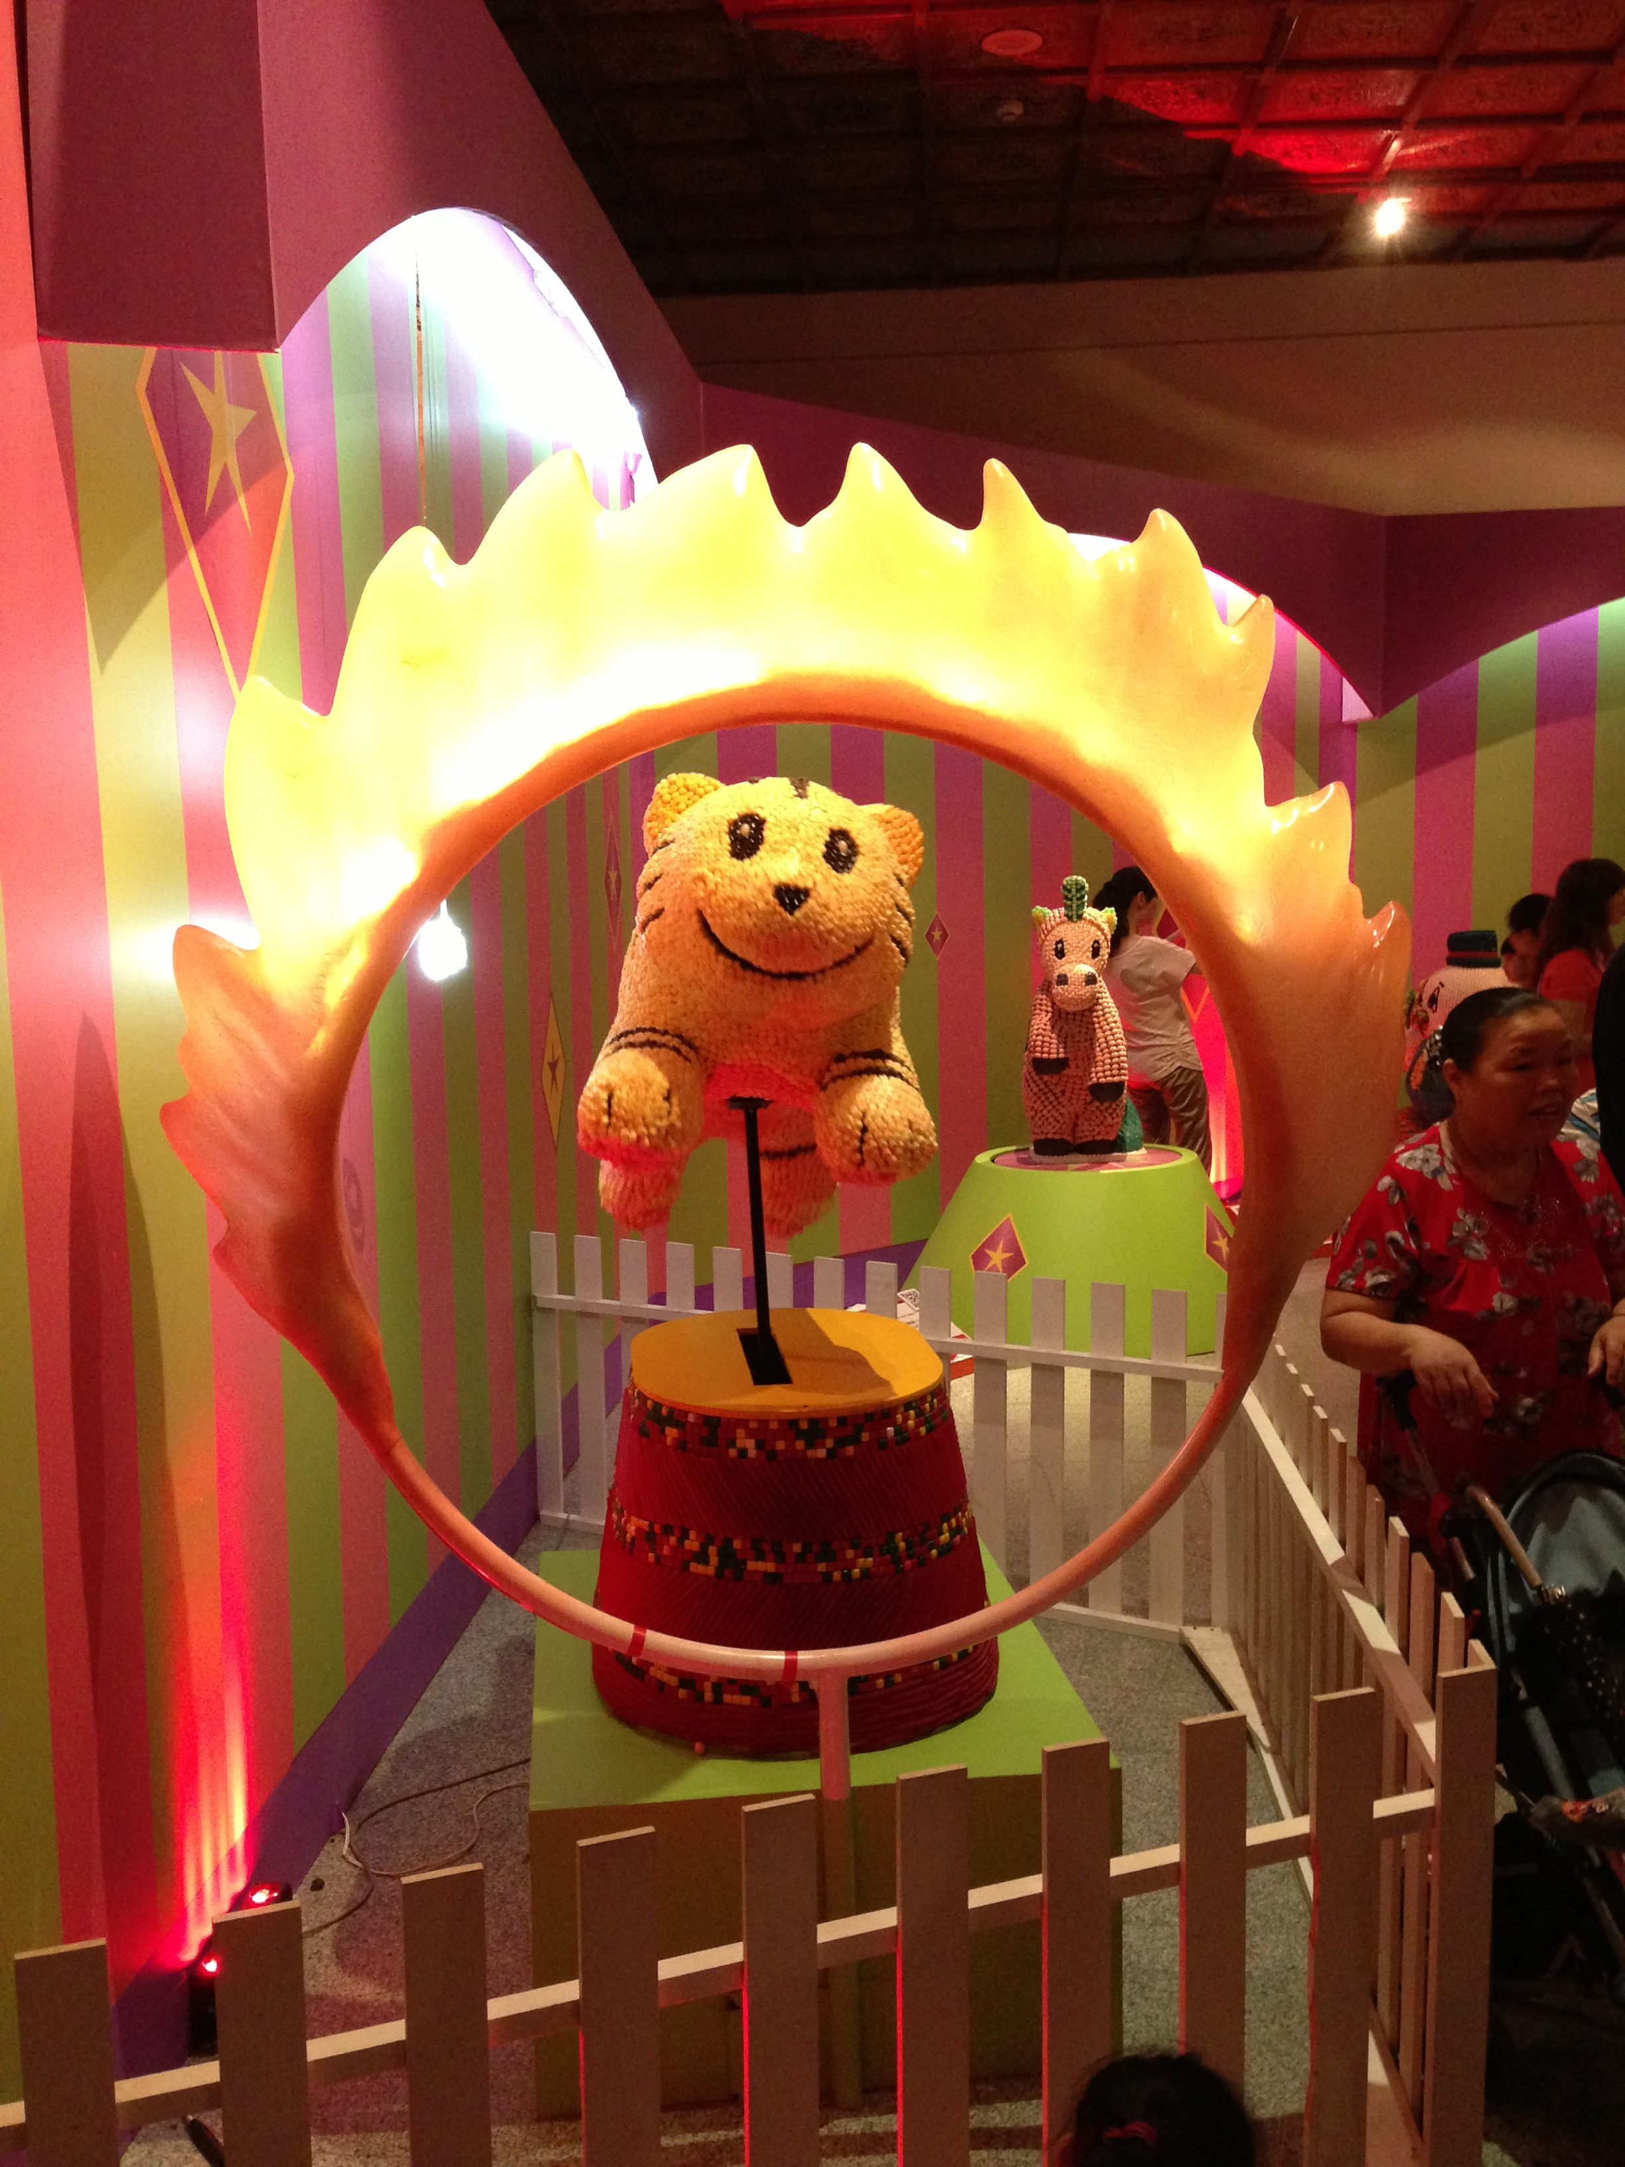
Culture
Left to Right: Monster Mango Shaved Snow, Chiang Kai Shek Memorial, a Candy Tiger at a Candy Art Exhibition

Slide 9
Acknowledgements
Mentors
Tony Fountain (CALIT2)
Chau Chin Lin (TFRI)
Sheng-Shan Lu (TFRI)
Yu-Huang Wang (TFRI)
Peter Shin (CALIT2)
PRIME
Peter Arzberger
Gabriele Wienhausen
Teri Simas
Tricia Taylor

